Slide 1
Where to live in Delft?

Slide 2
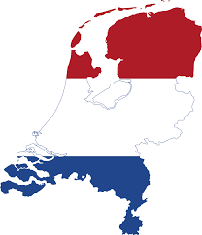
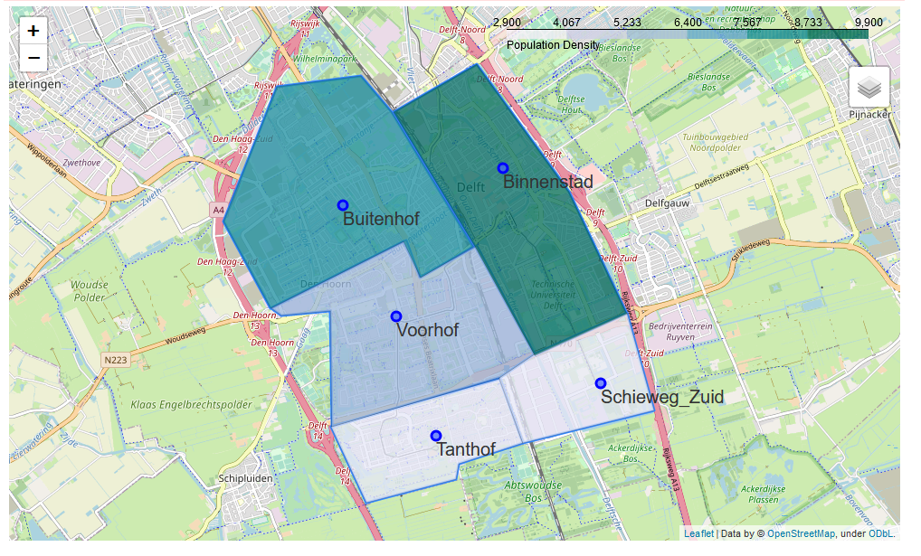
Where to live in Delft?
This study will develop a model to determine good neighborhoods in Delft to settle for young adults.

Slide 3
Data Collection:
Open source data has been used for this analysis:
FourSqaure API
Open data Delft

Slide 4
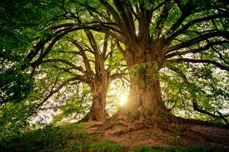
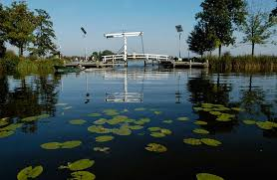
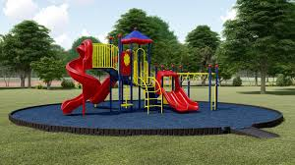
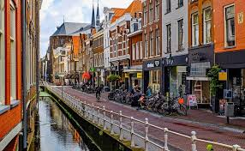
Model Features:
Features will be:
Tree population density per neighborhood
Water area density per neighborhood
Playground Tree population density per neighborhood
Venues -> clustered in three groups and weighted according to personal preference.
Trees in Delft
Water in Delft
Playground in Delft
Venues in Delft

Slide 5
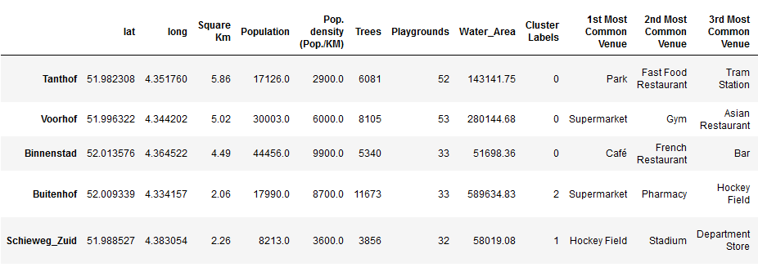
KMN clustering of Venues in Delft
Cluster where categorized based on the frequency of there venues.
Cluster 0: Restaurant heavy
Cluster 1: Shop heavy Area
Cluster 2: Sport area heavy
Will later be used to give weight to each preference

Slide 6
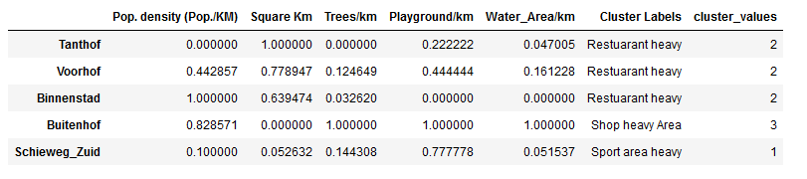

Attraction index model for each neighborhood of Delft
Normalized data by max value per column
Weigh_factors (w_k):
Column Value
w_pop_density = 4
w_trees = 1
w_playgroud = 3
w_water = 5
w_clusterLabel → table

Slide 7
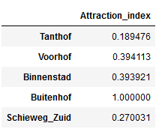
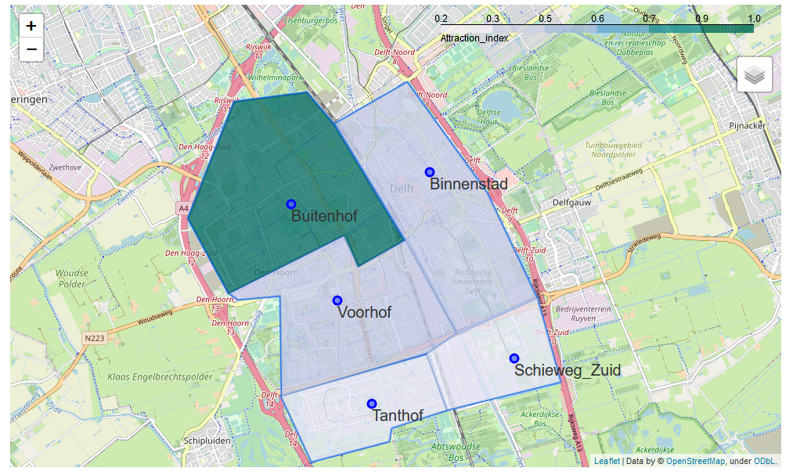
Final Result

Slide 8
Discussion & Conclusion
Conclusion:
Best place to live in Delft (according to this model) “Buitenhof”
Model Limitations:
The current model is heavily subjected to the author’s preferences, and can not be used as a general case. Different people value different things. The weight factors should be personalized every time you run the model.
The same holds for the feature selection, the current selected features show a strong personal opinion. Many more features can be though of e.g. crime rates, house values, etc. Due to limitation in data availability, these have not been selected.

